Slide 1
B.Sc. Computer Science | VIT Vellore
Adaptive Deep Learning
Framework For Flood &
Landslide Detection
Using Aerial Image Segmentation
Presented by
Linkesh E P | 23BCS0160
Under the guidance of Dr. Suganya P
SCORE | April 2026 | UCSC398J

Slide 2
Introduction
Understanding the Need for AI in Disaster Management
Natural disasters such as floods and landslides are among the most destructive events on Earth. With climate change accelerating their frequency, the need for an intelligent, fast, and accessible detection system has never been greater.
🌊
⛰
⏱
🤖
Floods
Landslides
Response
AI Role
Cause ~6,000 deaths and $30B+ in damage every year worldwide
Kill over 4,000 people annually — often secondary to heavy rainfall
Delayed detection is the primary cause of increased casualties
Deep learning can detect disaster conditions from images in real time
2 / 18

Slide 3
Problem Statement
What challenges does this project address?
🚨 Core Problem
Existing disaster detection methods are expensive, slow, and inaccessible to the general public — leaving communities without timely warnings.
1. Manual & Slow
2. Error-Prone
3. Costly Infrastructure
Traditional methods rely on human observation, satellite monitoring, and on-site personnel — not real-time.
Manual detection is subject to human error and delays — critical seconds lost during actual disasters.
Existing automated systems require high-end sensors, specialized hardware, and large budgets.
4. No User Accessibility
5. No Severity Info
No simple tool exists for citizens to identify disaster types and get emergency help from their devices.
Even when detection occurs, there is no immediate severity classification or actionable emergency guidance.
3 / 18

Slide 4
Objectives
What this project aims to achieve
Adaptive DL Framework
Accurate Classification
🧠
🎯
Develop an adaptive deep learning framework using CNN for automated disaster detection from images
Classify images accurately into Flood, Landslide, or Normal categories with confidence scoring
Real-Time Detection
Location Tracking
⚡
📍
Provide real-time prediction results including disaster type, severity level, and confidence score
Capture the user's real-time GPS coordinates and convert to a readable address using APIs
Emergency Assistance
Web Application
🚨
🌐
Give quick access to Police, Fire, and Ambulance services along with Google Maps navigation
Build and deploy a user-friendly Flask web application accessible via any standard browser
4 / 18

Slide 5
System Overview
How the AI Disaster Detection System Works
The proposed system is a web-based AI application where users upload a disaster image and receive instant classification (Flood / Landslide / Normal), a confidence score, severity level, real-time location, and emergency support — all in one interface.
1
2
3
4
5
6
User
Uploads Image
Location
Captured
Image
Preprocessed
CNN
Analyzes
Results
Displayed
Emergency
Support
Input
Output
• User name & phone number
• Disaster image (JPG/PNG)
• Browser GPS location (automatic)
• Submitted via web form (Flask)
• Disaster type: Flood / Landslide / Normal
• Severity: Safe / Low / Moderate / High
• Confidence score in percentage
• Emergency help + Google Maps link
5 / 18

Slide 6
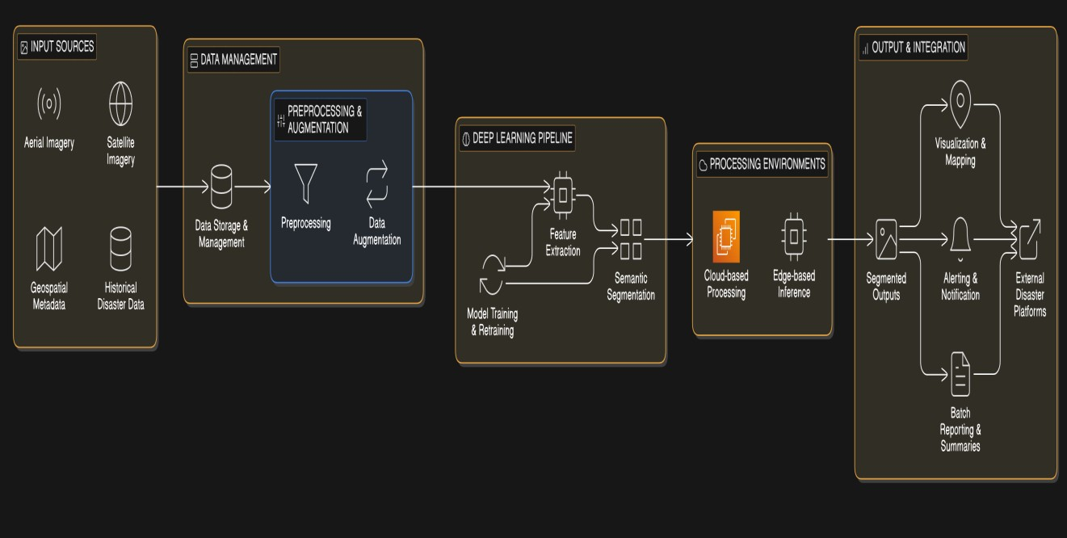
System Architecture Diagram
How the AI Disaster Detection System Works
5 / 18

Slide 7
System Architecture
Client–Server Architecture with Deep Learning Pipeline
FRONTEND
(Browser)
BACKEND
(Flask Server)
OUTPUT
(Response)
HTML + CSS + JavaScript
Flask routes & API handling
Disaster type + confidence
Image upload form
OpenCV preprocessing
Severity classification
GPS geolocation capture
→
CNN model (TensorFlow/Keras)
→
Location: lat/lon + address
Result display interface
OpenStreetMap address API
Emergency service buttons
6 / 18
Architecture includes UML diagrams: Use Case, Structured Component, and Class diagrams — covering all system actors and interactions.

Slide 8
Technologies Used
Tools, Languages, Libraries & Platforms
Language
Framework
Deep Learning
Python 3.x — primary language
Flask — web backend & routing
TensorFlow / Keras — CNN model
HTML5, CSS3, JavaScript — frontend
Gradio — alternate UI experimentation
CNN architecture — custom built
Image Processing
APIs & Tools
Platform
OpenCV (cv2) — resize, normalize
Geolocation API — GPS capture
Google Colab — model training
Canny Edge Detection — landslide support
OpenStreetMap — address conversion
VS Code — development IDE
Google Maps — navigation link
Git — version control
7 / 18

Slide 9
Methodology
Research & Development Approach
Data Collection
Data Preprocessing
01
Images of Flood, Landslide, and Normal environments collected from Google Images, Kaggle, and public repositories. JPG/PNG format, organized in class-specific folders.
02
All images resized to 224×224 pixels and pixel values normalized to [0,1] range using OpenCV. Balanced classes to prevent model bias during training.
Model Design
Hybrid Detection
03
CNN architecture designed with Convolutional, Pooling, and Dense layers. Trained on Google Colab. Saved as .h5 format for deployment in Flask backend.
04
CNN classification combined with Canny Edge Detection for improved landslide identification. Decision module assigns final disaster type, severity, and confidence.
System Integration
Testing & Validation
05
Trained model integrated into Flask web app. Location module captures GPS, converts to address via API. Emergency services and Google Maps link added.
06
System tested with diverse real-world images: flood scenes, landslide areas, and normal environments. Accuracy, Precision, Recall, and F1-Score measured.
8 / 18

Slide 10
Model — CNN (Convolutional Neural Network)
The Core Intelligence Behind Disaster Detection
Input
224×224×3
Conv
Layer 1
Max
Pooling
Conv
Layer 2
Max
Pooling
Flatten
Dense
Layer
output
3 Classes
How the CNN Works
Severity Classification
Input image resized to 224×224 px and normalized
> 75%
HIGH
Convolutional layers extract visual features (edges, textures, colors)
60 – 75%
MODERATE
Pooling layers reduce dimensions while retaining key features
Flattened into 1D vector and passed to Dense layers
40 – 60%
LOW
Output layer gives probability for each of 3 disaster classes
< 40%
SAFE
argmax() selects highest-probability class as final prediction
If confidence < 50% → forced to NORMAL regardless of class prediction
9 / 18

Slide 11
Working Process
End-to-End Step-by-Step System Flow
1
👤 User Input
2
🖼 Image Upload
User enters name & phone number on the web interface
User uploads a disaster image (JPG/PNG format)
3
📍 Location Capture
4
⚙ Preprocessing
Browser captures GPS coordinates via Geolocation API
OpenCV resizes image to 224×224 px and normalizes pixels
5
🧠 CNN Prediction
6
📊 Confidence Score
Model classifies: Flood, Landslide, or Normal
Prediction probability (%) is computed for the result
7
⚠ Severity Analysis
8
🗺 Address Conversion
System assigns: SAFE / LOW / MODERATE / HIGH risk
Lat/Lon converted to readable address via OpenStreetMap API
9
📱 Output Display
10
🚨 Emergency Support
All results shown on web page with location details
Police, Fire, Ambulance buttons + Google Maps link shown
10 / 18

Slide 12
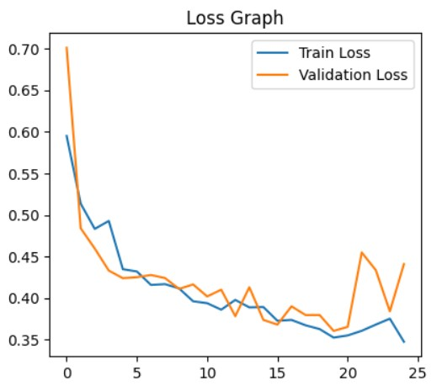
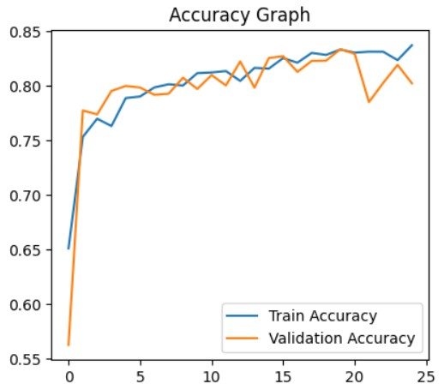
Performance Analysis
Accuracy, Metrics & Model Behaviour
~84%
~78%
~90%
Flood Accuracy
Landslide Acc.
Normal Accuracy
12 / 18

Slide 13
Output / Results
For Web Application
What the System Returns to the User
Sample Output → FLOOD | HIGH | 86.63% | Location: 13.1112, 80.2045 | Address: Chennai, Tamil Nadu, India
⚠
Disaster Type
📊
Confidence Score
🎯
Severity Level
FLOOD / LANDSLIDE / NORMAL
Prediction probability in percentage
SAFE / LOW / MODERATE / HIGH
e.g. FLOOD detected
e.g. 86.63%
e.g. HIGH risk
👤
User Details
📍
Location Info
🚨
Emergency Help
Name and phone number displayed
Lat/Lon coordinates + readable address
Police 🚔 Fire 🚒 Ambulance 🚑
e.g. Linkesh | 6379514030
e.g. 13.1112, 80.2045
+ Google Maps link
11 / 18

Slide 14
Output / Results
For DATABASE TRAINING DATA
What the System Returns to the User
Sample Output → FLOOD | HIGH | 86.63% | Location: 13.1112, 80.2045 | Severity :89.9% |
Time : 13:03:21
⚠
Disaster Type
📊
Confidence Score
🎯
Severity Level
FLOOD / LANDSLIDE / NORMAL
Prediction probability in percentage
SAFE / LOW / MODERATE / HIGH
e.g. FLOOD detected
e.g. 86.63%
e.g. HIGH risk
👤
User Telegram Alert
Notification
📍
Location Info
🚨
Time of Disaster
All the details wiilll be send to the telegram
Lat/Lon coordinates + readable address
Time will be noticed and send to the telegram
e.g. High flood /low /89.9
e.g. 13.1112, 80.2045
11 / 18

Slide 15
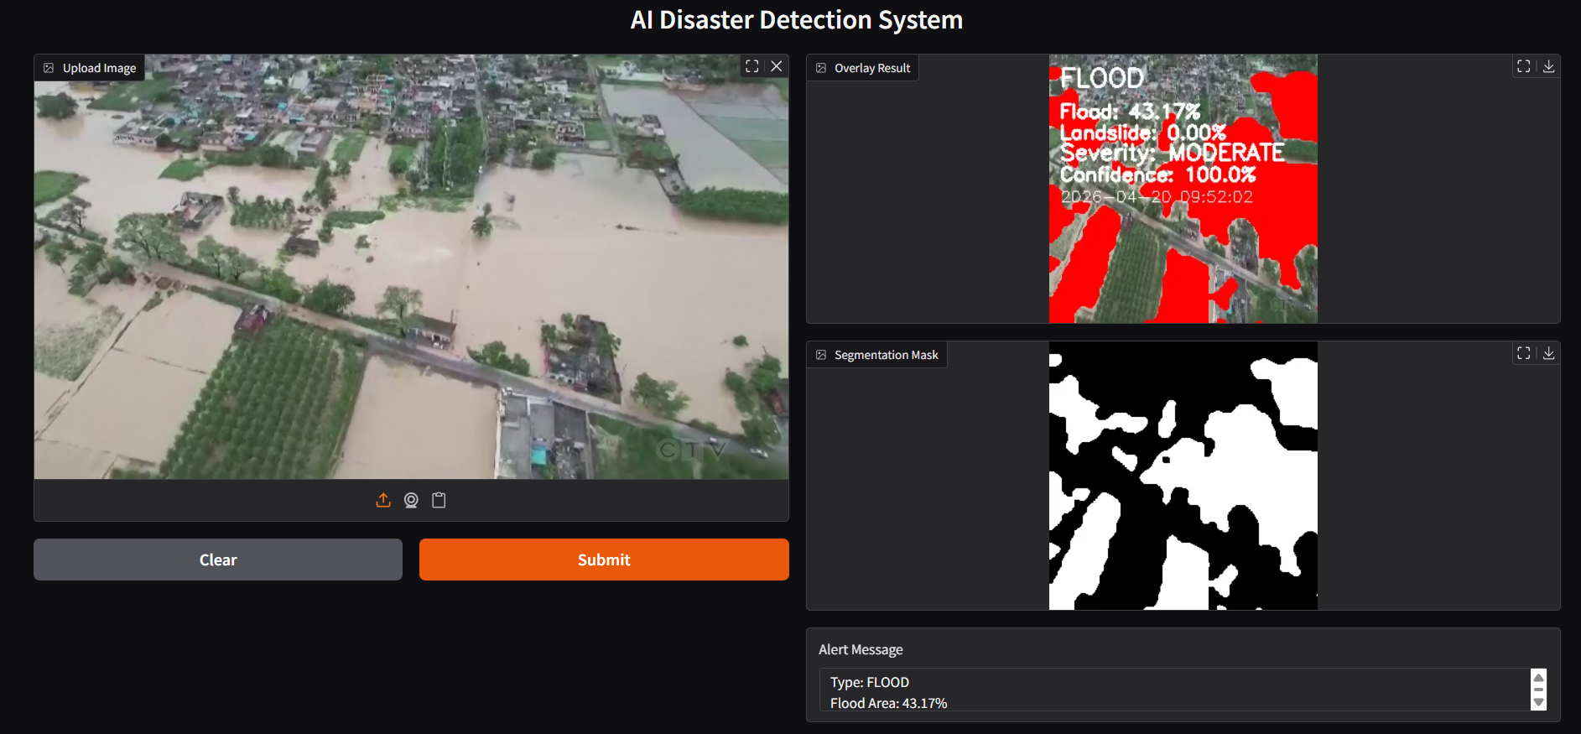
Output / Results
For DATABASE TRAINING DATA [FLOOD]
11 / 18

Slide 16
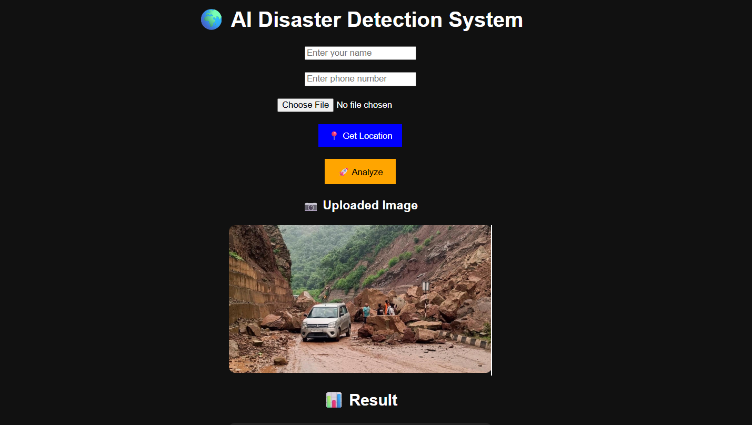
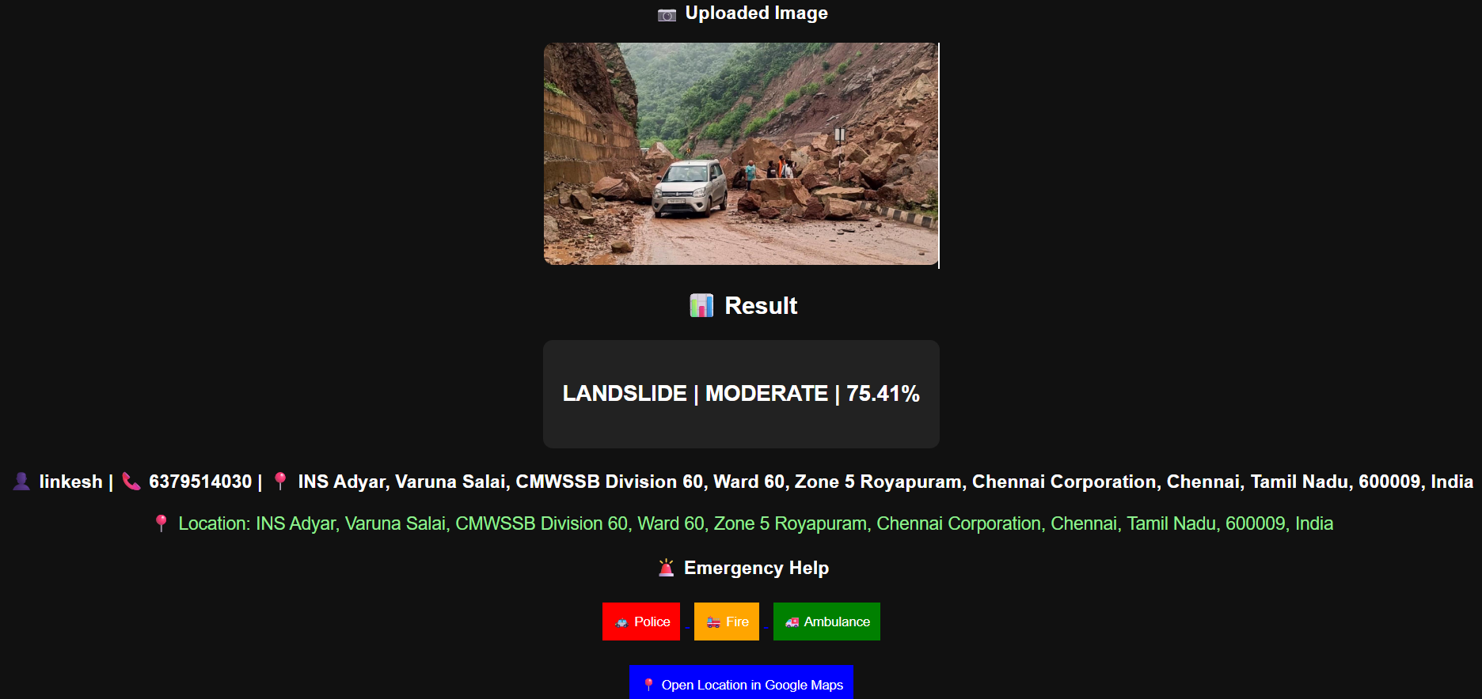
Output / Results
For Web Application
11 / 18

Slide 17
Features of the System
Key Capabilities That Make This System Unique
🧠
⚡
📊
⚠
AI-Powered Detection
Real-Time Prediction
Confidence Scoring
Severity Classification
Convolutional Neural Network classifies disaster images automatically with no human intervention required
System produces results instantly after image upload — suitable for emergency response situations
Every prediction comes with a confidence percentage so users understand how reliable the result is
Automatically assigns severity level — Safe, Low, Moderate, or High — to help users react appropriately
📍
🚨
🌐
💰
Location Tracking
Emergency Assistance
Web-Based Access
Cost-Effective
Browser-based GPS capture with OpenStreetMap API to convert coordinates to a readable address
One-click access to Police, Fire, and Ambulance services with Google Maps navigation link
Accessible via any browser on any device — no installation needed; built with Flask and HTML/CSS
Built entirely using free, open-source tools (Python, Flask, TensorFlow, Google Colab) — zero licensing cost
13 / 18

Slide 18
Limitations
Current Constraints of the System
Limited Dataset Size
Image Quality Dependency
1
The model is trained on a relatively small dataset collected from online sources. This may reduce the model's ability to generalize accurately to all real-world images and scenarios.
2
The accuracy of predictions heavily depends on input image quality. Blurry, dark, or low-resolution images can lead to misclassification or incorrect severity assignment.
Classification Only
Internet Dependency
3
The current system performs image-level classification — it cannot segment or pinpoint the exact region affected by a disaster within the image (no pixel-level analysis).
4
Features like Geolocation, address conversion (OpenStreetMap), and Google Maps navigation require a stable internet connection to function correctly.
Hardware Limitations
No Mobile App
5
Complex models like ResNet or segmentation networks (U-Net) could not be used due to standard hardware constraints and computational limitations.
6
Currently only a web application. There is no dedicated mobile (Android/iOS) application, which limits accessibility for field workers during actual disaster events.
14 / 18

Slide 19
Future Scope
Planned Enhancements & Research Directions
🛰
Aerial Image Segmentation
📱
Mobile Application
☁
Cloud Deployment
Integrate U-Net / Mask R-CNN for pixel-level disaster region mapping using satellite & drone imagery
Develop Android/iOS app for on-field disaster reporting and real-time detection without a browser
Deploy system on AWS/GCP for scalability, handling large concurrent users during mass disaster events
🔗
IoT Integration
🤖
Advanced Model Architecture
🌍
Multi-Disaster Support
Connect with IoT flood/rainfall sensors for multi-source detection beyond image-based classification
Experiment with ResNet, EfficientNet, and Vision Transformers for higher classification accuracy
Extend to detect earthquakes, wildfires, and cyclones — building a comprehensive disaster management AI
15 / 18

Slide 20
Conclusion
Summary of the Project
This project successfully demonstrates that deep learning — specifically Convolutional Neural Networks — can be effectively applied to detect natural disasters such as floods and landslides from images. The system provides real-time, accurate, and actionable results through a simple web interface.
✅ CNN model accurately classifies Flood, Landslide, and Normal images with stable training performance
✅ Real-time web application deployed with Flask — accessible, user-friendly, and requires no installation
✅ Location tracking and emergency services integrated — making the system a complete disaster response tool
✅ Entirely built using free, open-source tools — cost-effective and scalable for real-world deployment
🚀 Future work includes U-Net segmentation, mobile app, cloud deployment, and multi-disaster detection
16 / 18

Slide 21
References
Key Papers & Resources Consulted
1
Khan et al. (2021) — "Deep Learning-Based Image Segmentation Techniques: A Comprehensive Review"
IEEE Access
2
Marmanis et al. (2020) — "Multi-U-Net: A DL Framework for Multi-Class Segmentation in Aerial Images"
ISPRS Journal of Photogrammetry
3
Gupta et al. (2022) — "Real-Time Flood Detection from Aerial Images Using Deep Learning"
Natural Hazards
4
Sinha & Sen (2022) — "Impact of CNNs on Flood Detection Using Satellite Imagery"
Journal of Hydrology
5
Almazroi & Alarifi (2023) — "Enhancing Landslide Detection Using Machine Learning & Satellite Imagery"
Applied Sciences
6
Ghosh & Dutta (2022) — "Disaster Detection Using Image Segmentation"
Remote Sensing Journal
7
Rahman et al. (2021) — "Deep Learning Based Flood Detection Using Satellite Imagery"
IEEE Remote Sensing
8
Nguyen & Kim (2022) — "Multi-Modal Deep Learning for Disaster Image Analysis"
IJAEOG
17 / 18

Slide 22
Thank You!
Questions & Discussion Welcome
Presented by
Guide
Project Code
Linkesh E P | 23BCS0160
Dr. Suganya P, SCORE, VIT Vellore
UCSC398J | April 2026
"Harnessing AI to save lives — one image at a time."
Adaptive Deep Learning Framework For Flood and Landslide Detection Using Aerial Image Segmentation

